Slide 1
5200 Practicum I
By Shuyue Gao, ShuHong Chan, Jingjing Zhu, Xingguo Huang

Slide 2
Contributions
Task 1: Shuyue Gao
Task 2: Shuhong Chan, Xingguo Huang
Task 3: Shuhong Chan, Xingguo Huang, Shuyue Gao
Task 4: Shuyue Gao
Task 5: Jingjing Zhu, Shuyue Gao
Task 6: Jingjing Zhu
Task 7: Jingjing Zhu
Task 8: Xingguo Huang
Task1 - 8: according to the Assignment Tasks
Task details: https://northeastern.instructure.com/courses/123304/assignments/1505049

Slide 3
Discussing Contents Today
Shuyue Gao: UML and Crow's Foot Relational Schema
ShuHong Chan: SQL DDL statements and Load the Bird Strikes CSV file into R and populate the tables with the data
Jingjing Zhu: SQL queries and visualization using R
Xingguo Huang: stored procedure in MySQL that removes a bird strike incident from the database.

Slide 4
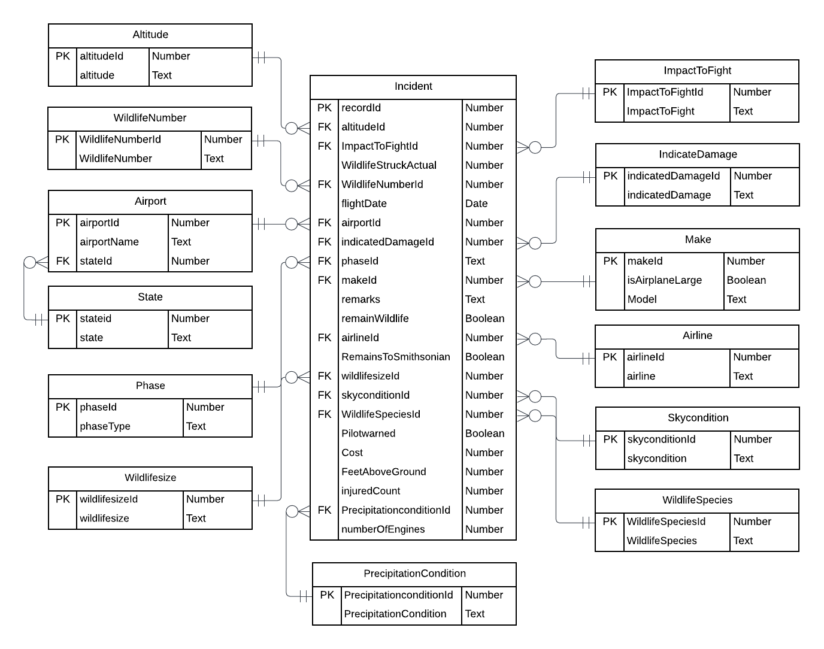
Crow's Feet Relational Schema

Slide 5
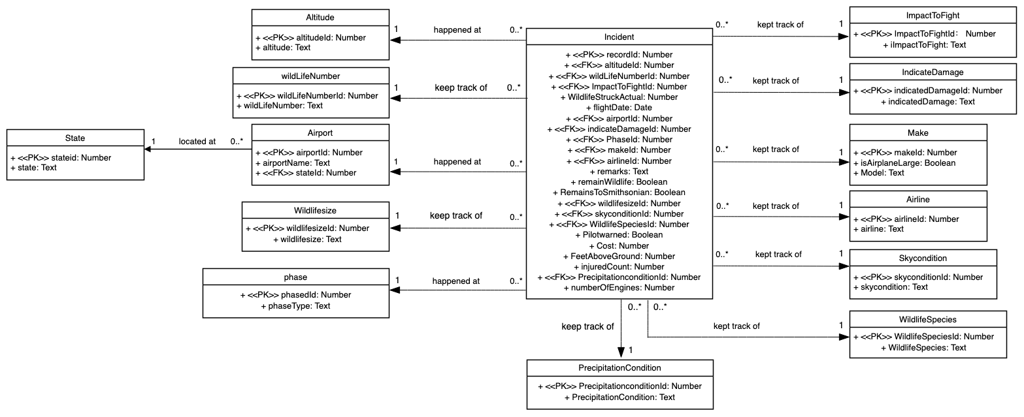
UML

Slide 6
Load the Bird Strikes CSV file and
populate the tables with data
1. Load CSV file to R as a data frame
2. Rename the column (remove any ‘…’)
3. Copy all the data from data frame to a table (master table)
4. Cleaning data in master table
5. Create all related tables and copy the data from master table

Slide 7
Load the Bird Strikes CSV file and populate the tables with data
1. Load CSV file to R as a data frame
Load all the data in csv file to R as a data frame with the function of read.csv()
path = "/CS5200/Assignments/Practicum1/"
fn <- "BirdStrikesData-1.csv"
fileName <- paste(path, fn, sep = "/")
birdStrikesDF <- read.csv(fileName, header = TRUE, stringsAsFactors = FALSE)
head(birdStrikesDF,4)

Slide 8
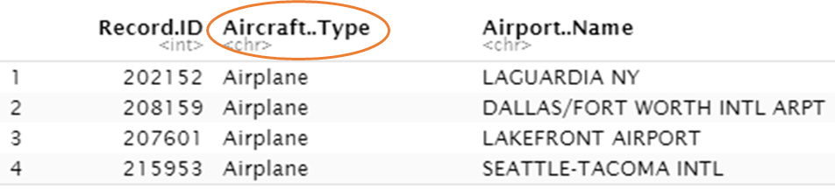
Load the Bird Strikes CSV file and populate the tables with data
2. Rename the column (remove any ‘…’)
- some header names in CSV file were included some special characters (e.g. ‘:’, ‘/’, ‘?’, ‘$’)
- after save to a data frame, the special characters (includeing space) will change to ‘.’
- for example: Aircraft : Type > Aircraft..Type
- ‘Aircraft..Type’ is not a legal column name, we have to rename it with colnames() function
colnames(birdStrikesDF)[1] <- "RecordID"
colnames(birdStrikesDF)[2] <- "Aircraft_Type“
:
:

Slide 9
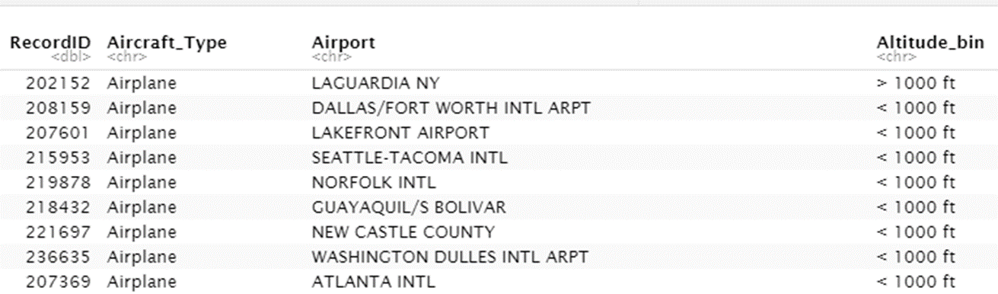
Load the Bird Strikes CSV file and populate the tables with data
3. Copy all the data from data frame to a table (master table)
Copy all the data from data frame to a table, called master, with the function of dbWriteTable()
dbWriteTable(mydb, "master", birdStrikesDF, overwirte = T);

Slide 10
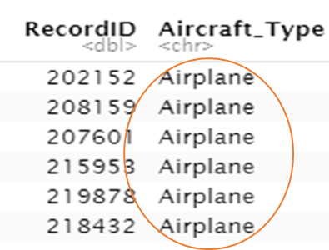
Load the Bird Strikes CSV file and populate the tables with data
4. Cleaning data in master table
- As mentioned in the our tasks, records from the CSV that do not have flight or aircraft information may be omitted
- All records in master table without flight date information will be deleted
DELETE FROM master WHERE FlightDate = ''
- After remove all the records without flight date information, we found all the record data of column ‘Aircraft: Type’ (the column header name in CSV) are the same, ‘Airplane’
- We think the information in this column will not affect the data analysis of the data in this CSV file, so we skip the data of this column

Slide 11
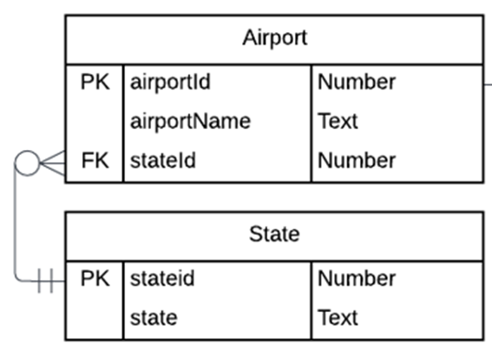
Load the Bird Strikes CSV file and populate the tables with data
5. Create all related tables and copy the data from master table
- According to the schema defined above, create all related tables with data
- For example, create the table of state and airport with Primary Key and Foreign Key
CREATE TABLE state(
stateid INTEGER PRIMARY KEY AUTO_INCREMENT,
stateName TEXT NOT NULL
);
INSERT INTO state (stateName) SELECT state FROM master GROUP BY state;
CREATE TABLE airport(
airportid INTEGER PRIMARY KEY AUTO_INCREMENT,
airportName TEXT NOT NULL,
stateid INTEGER NOT NULL,
FOREIGN KEY (stateid) REFERENCES state(stateid)
);
INSERT INTO airport (airportName, stateid)
SELECT master.airport, state.stateid
FROM master, state
WHERE master.state = state.stateName
GROUP BY master.airport, state.stateid;

Slide 12
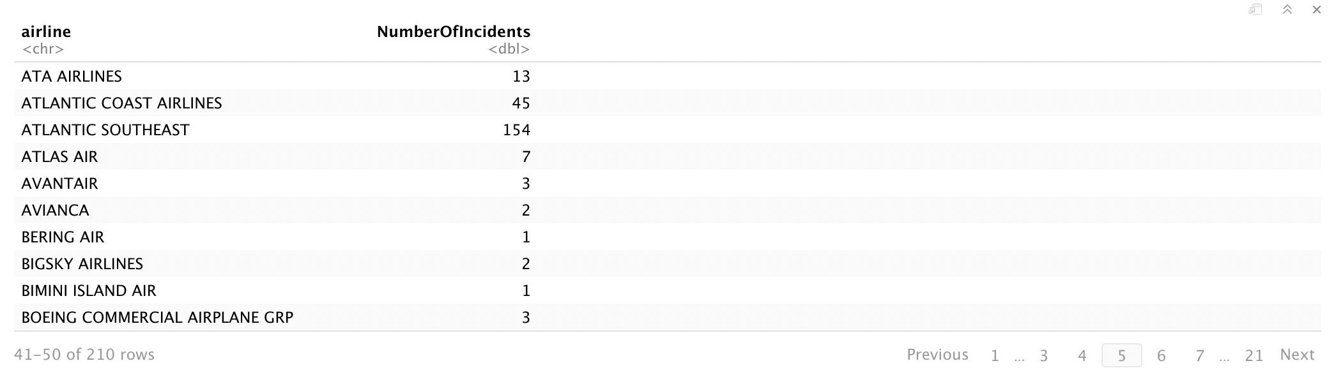
Query number of incidents at take-off/climb
SELECT a.airline, COUNT(DISTINCT i.recordid) AS NumberOfIncidents
FROM phase p
JOIN incident i USING (phaseid)
JOIN airline a USING (airlineid)
WHERE p.phaseType = 'Take-off run' OR p.phaseType = 'Climb'
GROUP BY a.airlineid
ORDER BY a.airlineid;

Slide 13
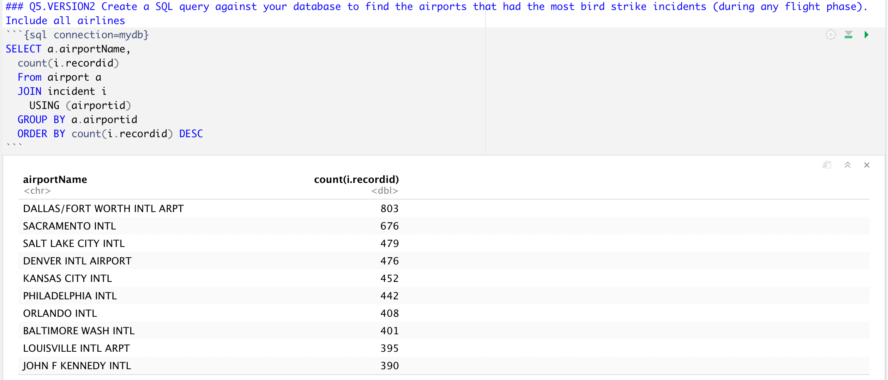
Query the airport had the most incidents

Slide 14
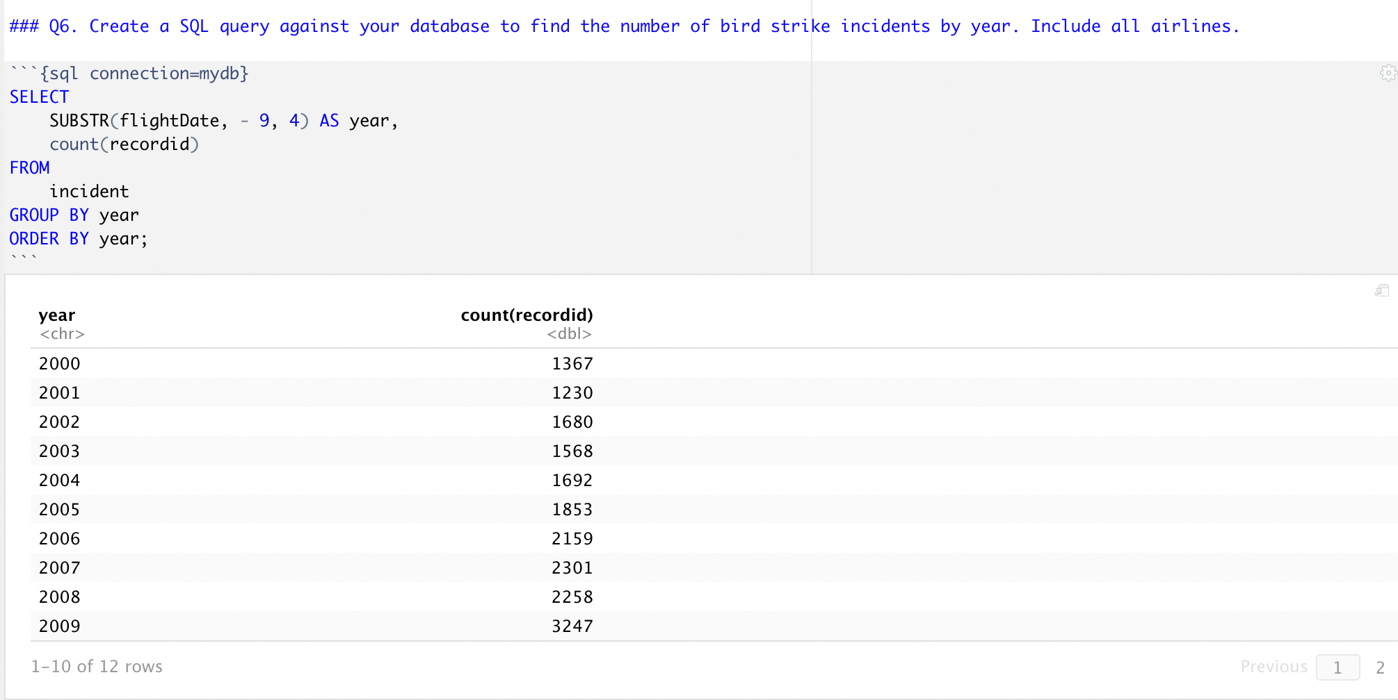
Query number of incidents by year

Slide 15
Build a visualized column chart - step summary
1. Query number of incidents per year from 2008 to 2011 during take-off/climbing
2. Query number of incidents per year from 2008 to 2011 during descent/approach/landing
3. Create data matrix & build the column chart

Slide 16
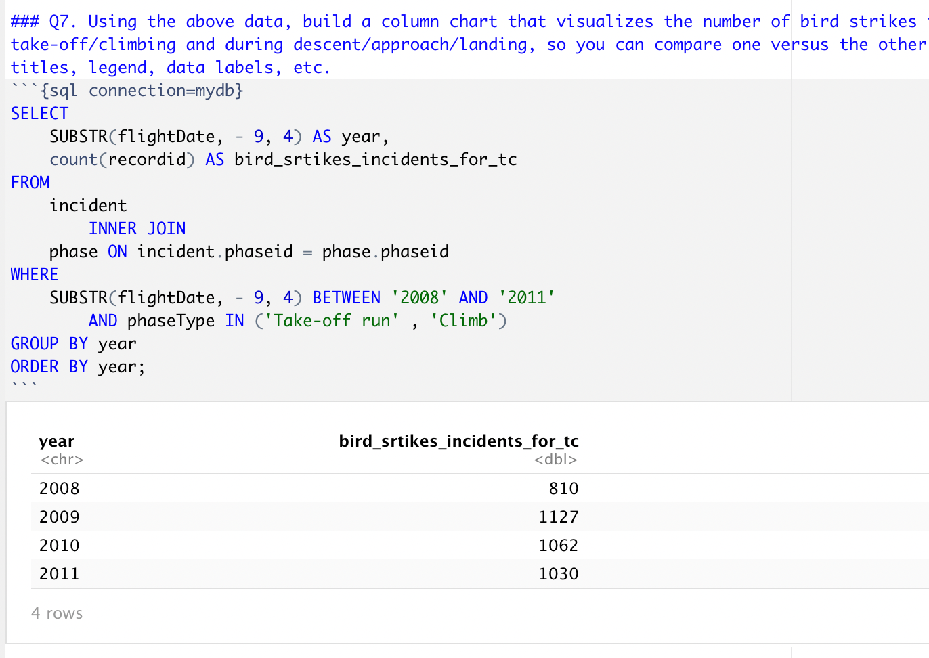
Build a visualized column chart - step 1
1. Query number of incidents per year from 2008 to 2011 during take-off/climbing

Slide 17
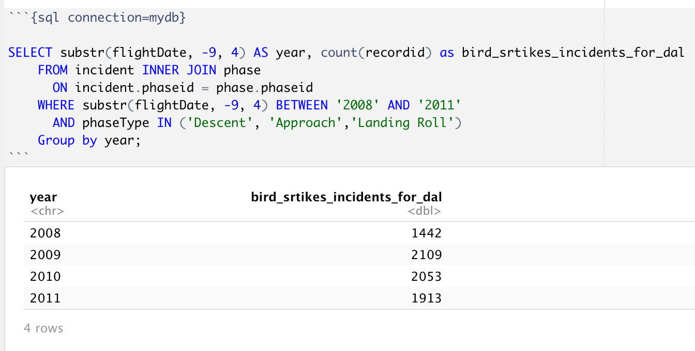
Build a visualized column chart - step 2
2. Query number of incidents per year from 2008 to 2011 during descent/approach/landing

Slide 18
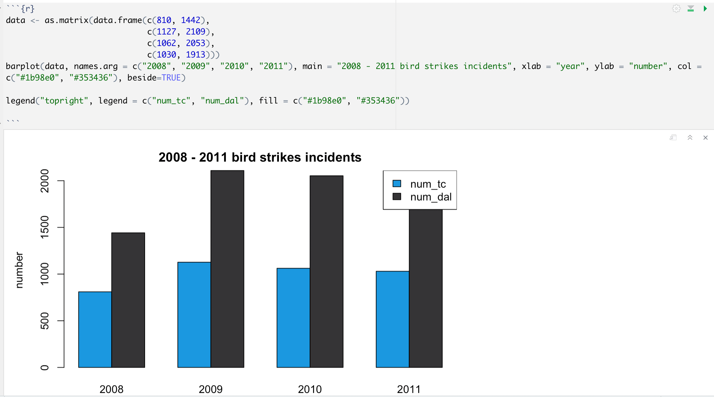
Build a visualized column chart - step 3
3. Create data matrix & build the column chart

Slide 19




Slide 20
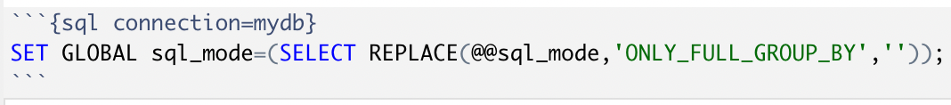
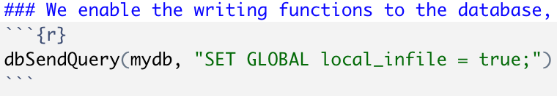
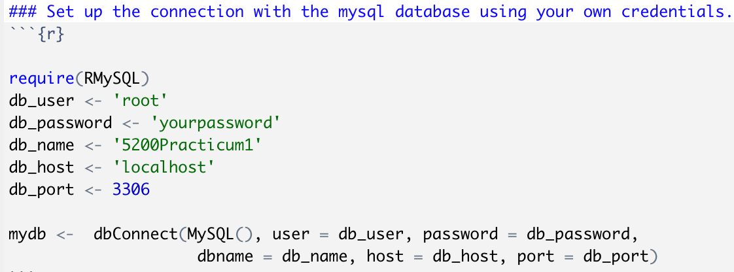
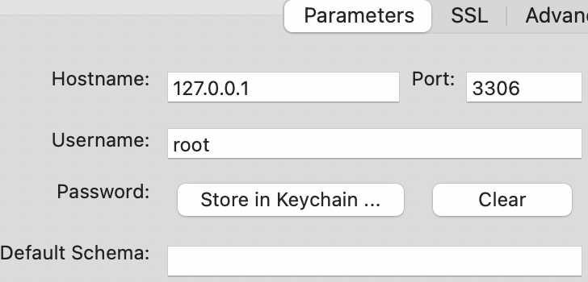
Source:
https://stackoverflow.com/questions/23921117/disable-only-full-group-by
https://stackoverflow.com/questions/57758553/how-to-fix-error-in-localconn-statement-could-not-run-statement-the
Notes:
Error in .local(conn, statement, ...) :
could not run statement: Loading local data is disabled; this must be enabled on both the client and server sides

Slide 21

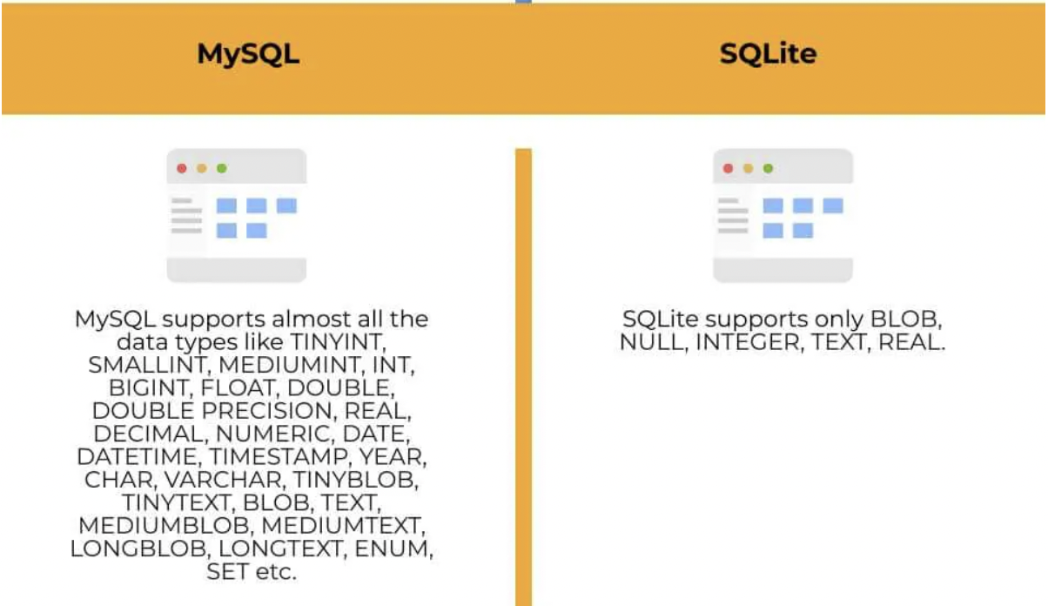
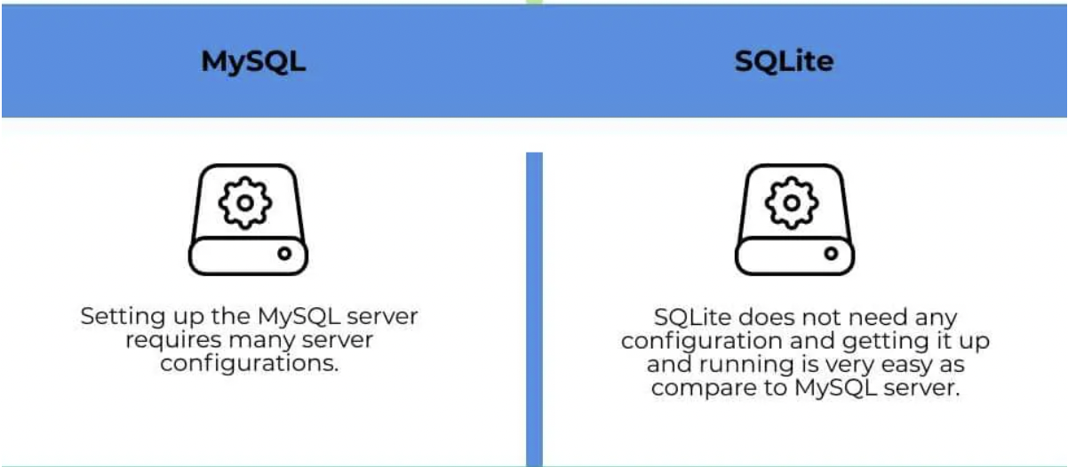
Source：https://www.educba.com/mysql-vs-sqlite/
https://dev.mysql.com/doc/refman/8.0/en/datetime.html#:~:text=MySQL%20retrieves%20and%20displays%20DATETIME,%3A14%3A07'%20UTC.

Slide 22

